Slide 1
Trees, Trees, Trees
Elisabeth Freimann, Simon Kohler, Fabian Lüthard,

Slide 2
Impact of trees on climate in Zürich
“Planting of trees positively impacts air quality and has some cooling effect”
1
Several studies verify this – is there an effect in local areas
2
Development of tree planting, air quality and temperature in Zürich
3

Slide 3
Data
Temperature
Temperature across measuring stations in Zürich per day
Trees
Amount of trees planted in Zürich each year
Air Quality
Air Quality across measuring stations in Zürich per day

Slide 4

Sustainable Development Goals

Slide 5
System Model

Slide 6
Results
R Markdown
Tableau
Graphical analysis
Decomposition
Timeseries analysis
Correlation
Dashboard
District Comparisons
Map-based analysis

Slide 7
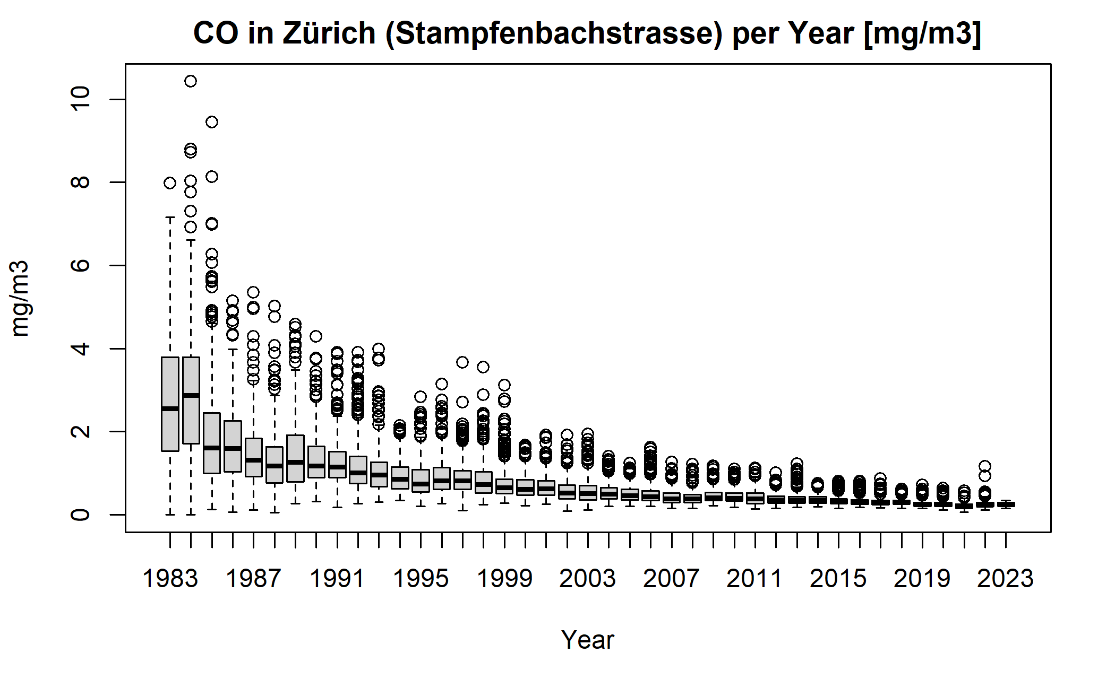
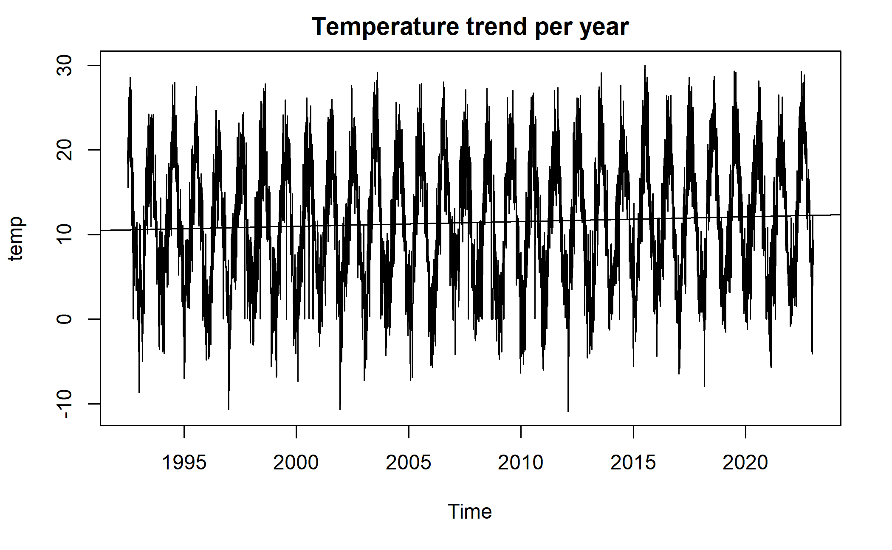
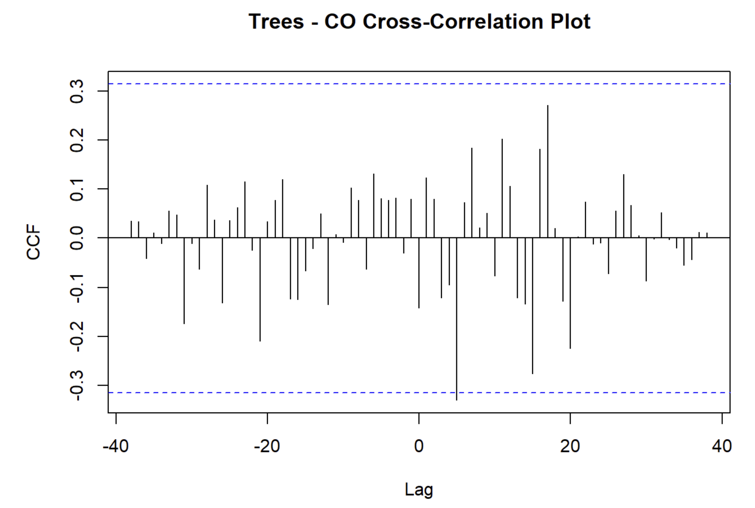
Graphical Analysis

Slide 8

Tableau - Dashboard

Slide 9
Key findings
Temperature rise is visible as a trend in Zürich
No clear correlation between amount of trees and temperature or air quality visible
Air quality has massively improved since the 1980s
Additional and more detailed data might lead to new observations

Slide 10
Q&A

